Slide 1

Azure Cost Implementation Kickoff

Slide 2
Azure Cost Implementation Kickoff
Goal
Reduce Azure Cost by
removing Orphaned resources,
implementing Rightsizing and
Suboptimal pricing strategies

Slide 3

Azure Cost Implementation Kickoff
Meet the Team
A. Datum Corporation
Victor Mushkatin
vmushkatin@vboxcloud.com
{{stakeholderEmails}}

Slide 4





Azure Cost Implementation Kickoff
Agenda
Meet the Team
ROB & Timeline
vBox Access & Demo
Q&A
Scoping

Slide 5
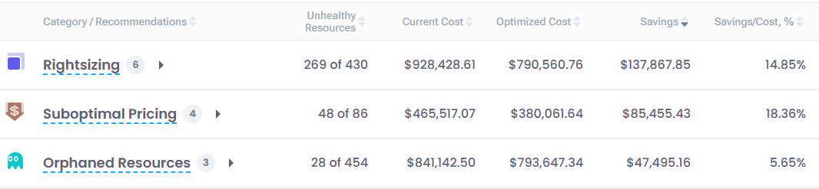
Azure Cost Implementation Kickoff
Scope

Slide 6
Azure Cost Implementation Kickoff
ROB & Timeline
Duration: 8 weeks engagement
Rhythm of Business (ROB):
On-boarding call/vBox setup
Kick off call/user on-boarding + program overview + initial scope definition
Weekly execution calls (6) to identify areas for improvement, assign tasks for customer team to execute on and review execution progress/blockers:
Week 1: Kick-off meeting
Week 2-5: Recommendations overview
Week 6-7: Address customer’s special requests
Week 8: Project Results Review

Slide 7
Azure Cost Implementation Kickoff
vBox on-boarding and scope review
Onboard vBox (if not done)
Enable PAL (Partner Admin Link)
Deploy Azure Optimization Assessment Offer
Delegate Reader Role
vBox User access
Users Emails
Accept consent
vBox Scope review
Cost Assessment
Recommendations
Initial Task Assignment

Slide 8

Azure Cost Implementation Kickoff
Q&A
Next Steps:
Weekly Meetings schedule
PTO/Holidays
Questions?

Slide 9
Visit our site to learn more:
https://www.litware.com

Slide 10
Check transcriptase and recording of the rally.
Meeting Summary

Slide 11
Recommendations:
The transcriptase and recording of a rally were being checked.
Action Items:
Check transcriptase and recording of the rally
Owner: Vladimir Makhnevich
Due: Not specified
Recommendations & Action Items

